Slide 1

Transparent and Genuine
Charity Application - Give Block Chain-
Chosun Univ.
Computer Engineering
20154192 이민재
20154265 이상규
20164223 류대식
20154290 이 준
Notes:
산학 캡스톤 디자인 4조 팀 홈플러스. 날씨를 기반으로 앱으로 작동이 되는 스마트 창문 발표를 시작하겠습니다.

Slide 2
CONTENTS
1
Business overview and introduction
2
Product Development plan introduction
3
Product details
4
Expectation Effectiveness

Slide 3
Business Overview And Introduction
1

Slide 4
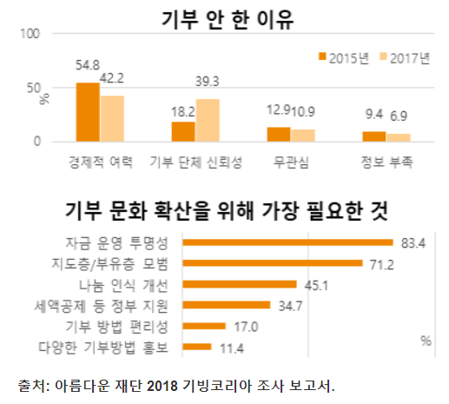
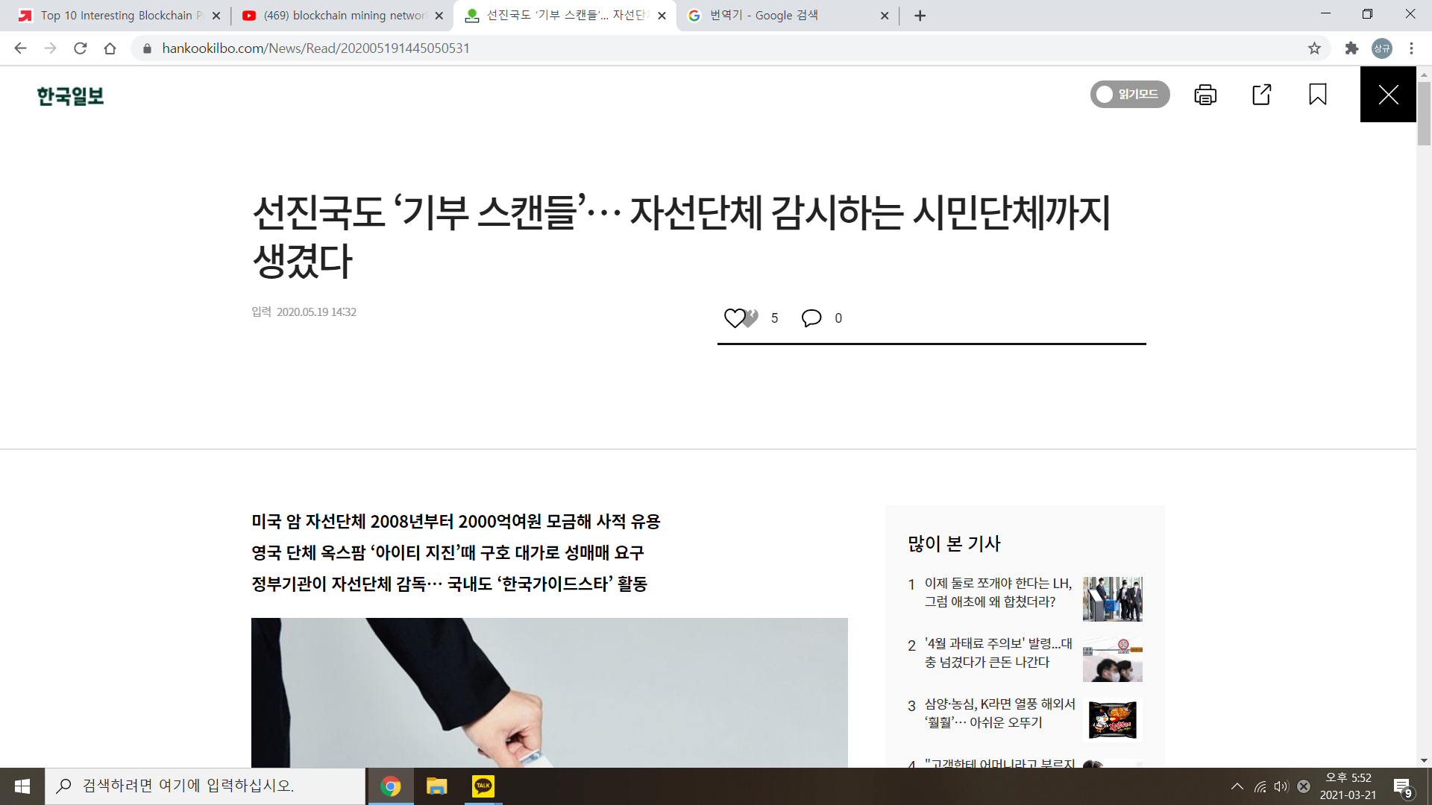
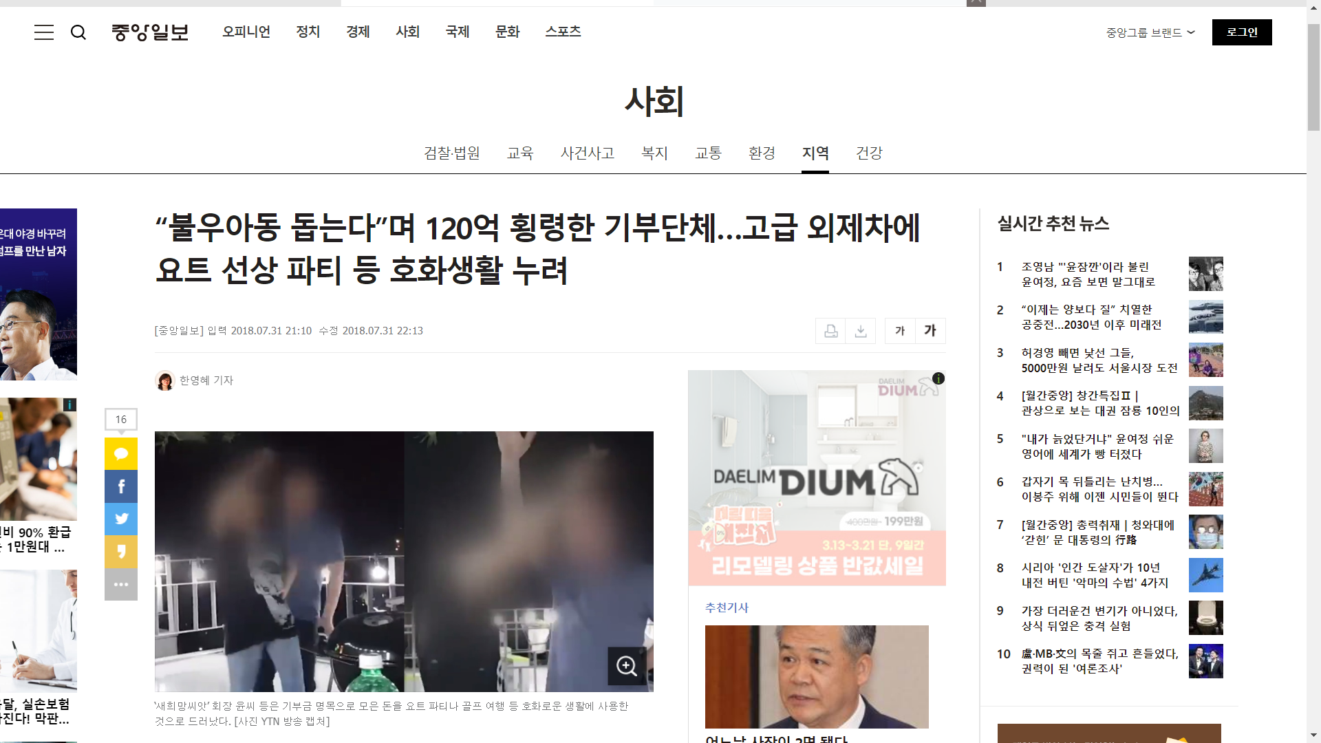
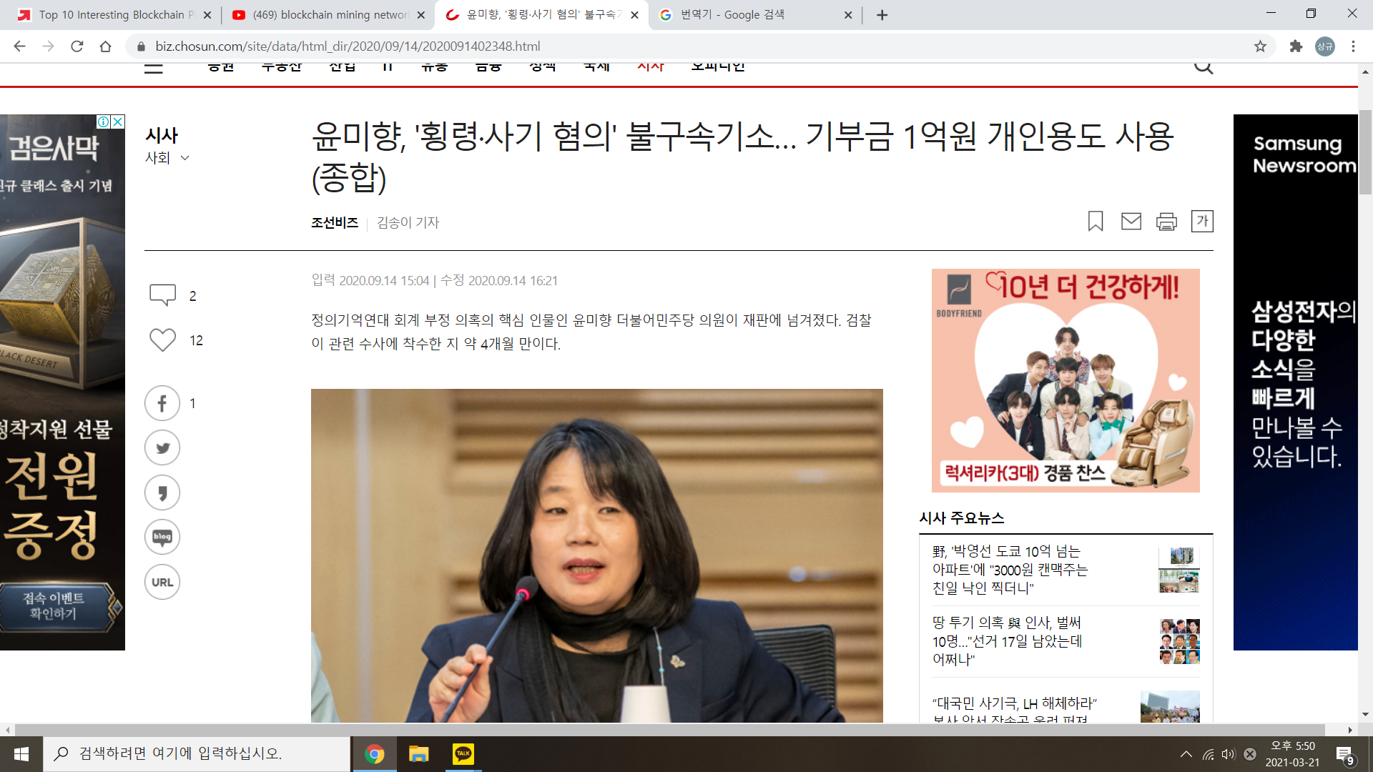
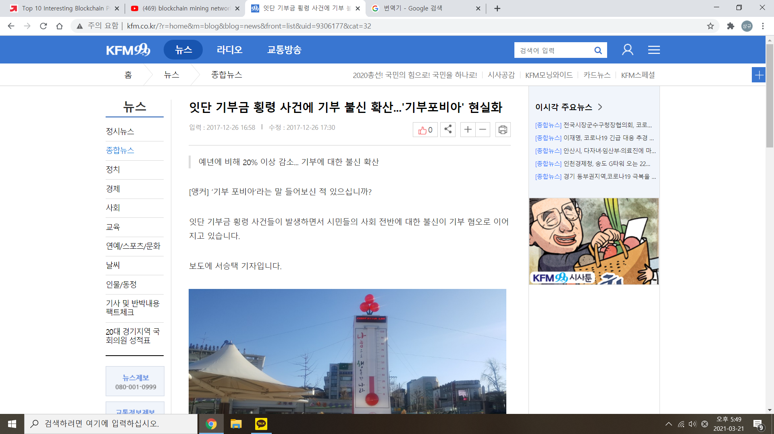
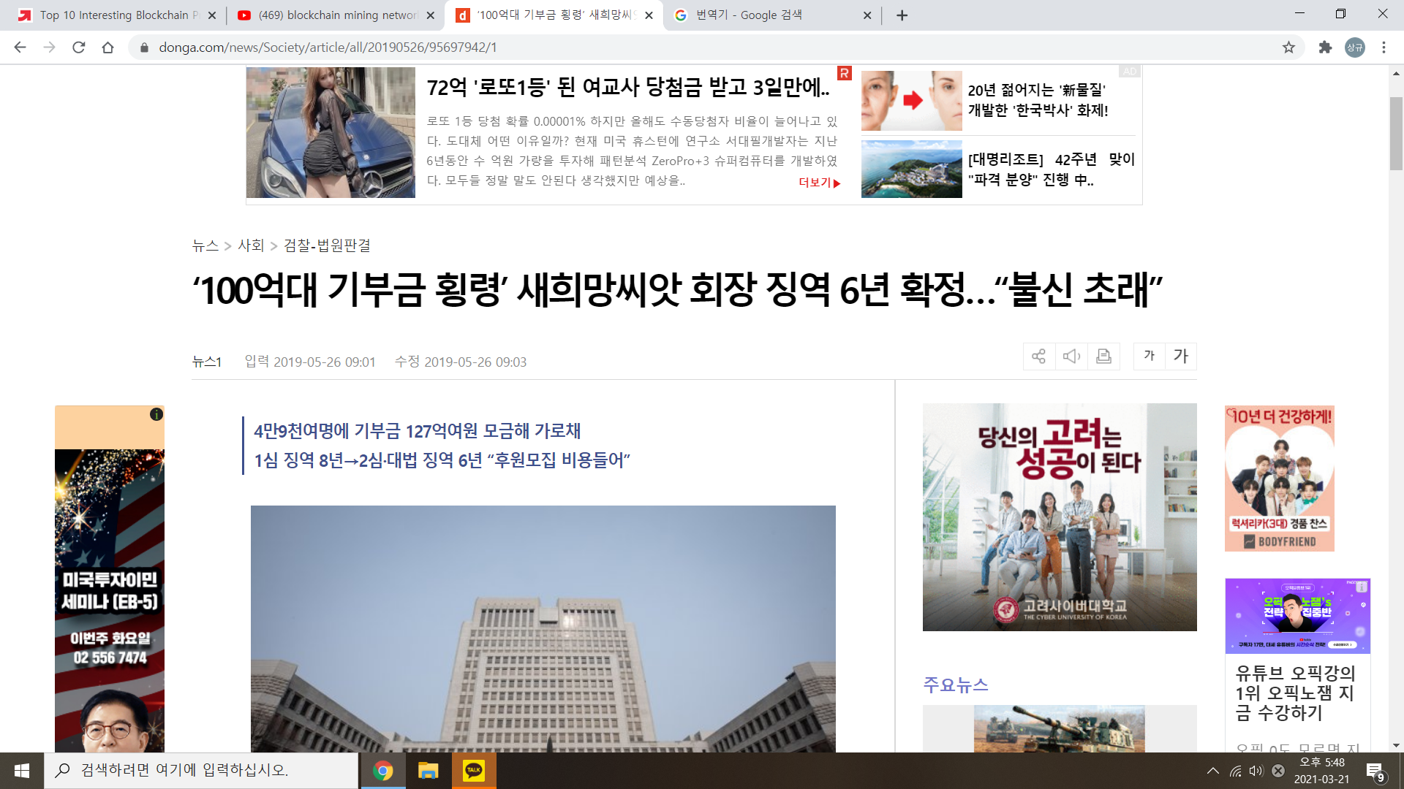
1
Business Overview and introduction The necessity of a product
출처 : 매일경제(https://www.mk.co.kr/news/economy/view/2017/04/237472/)

Slide 5
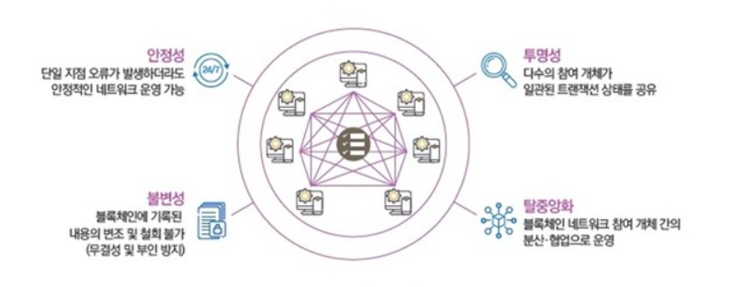
1
Business Overview and introduction
Block Chain

Slide 6
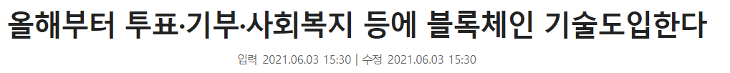
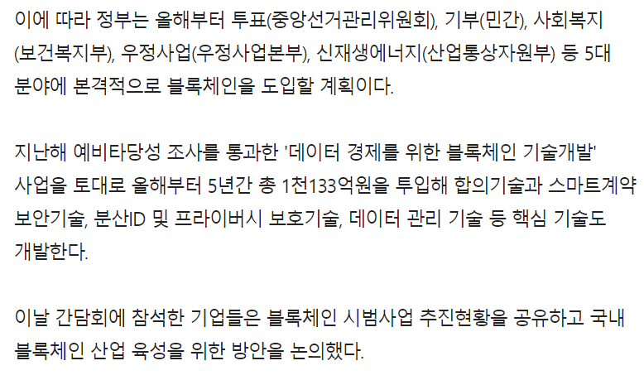
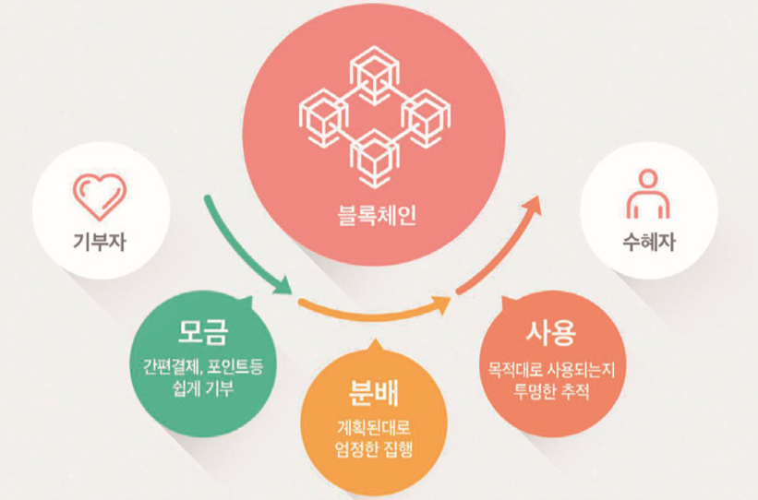
1
Business Overview and introduction
Differentiation
출처 : 연합뉴스(https://www.yna.co.kr/view/AKR20171226070100063)

Slide 7
Product Development plan Introduction
2

Slide 8






2
Product development plan introduction
Compare to existing product
?
Sender
Recipient

Slide 9

Product development plan introduction
2
Key Functions and Features (S/W)
Development plan
Existing system
Sender
Recipient
Market

Slide 10
2
Product development plan introduction
Structure and How It Works
Charity
Transaction
Use
Transaction
Block Chain
System

Slide 11
Product details
3

Slide 12







3
Product development plan introduction
Development Environment
Development Environment / language
Development tool
Notes:
저희의 개발환경과 개발도구들입니다.
VSC 에디터에서 언어는 node js 를 사용하였습니다.
개발도구들로는 DB에는 MySQL을 사용하였으며,
보안을 위한 암호화 알고리즘은 SHA256(Secure Hashing Argorithm 256)을 사용하였습니다.
웹 페이지를 나타내기위해 HTML에서 js 코드를 사용할 수 있게 해주는 EJS 템플릿을 사용하였고,
웹 프레임워크로는 Express를 사용하였습니다.

Slide 13
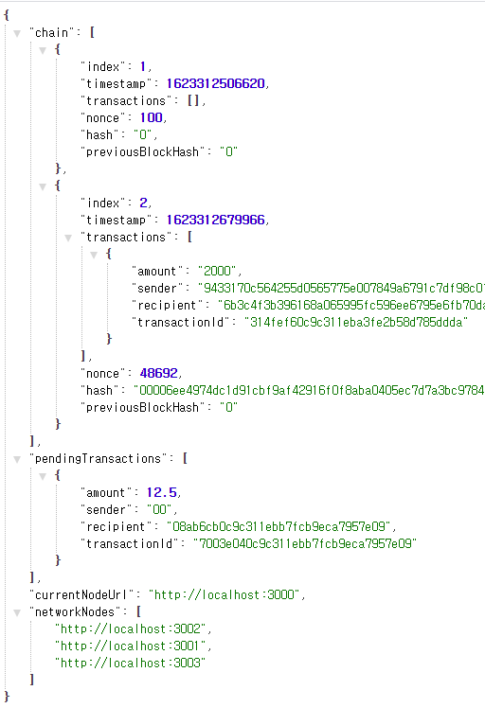
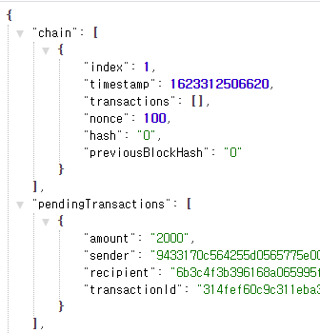
2
Product Details
3
Block chain Structure
Hash of the block
Index | Previous Block hash
Time | Nonce
Transaction Count
Transaction #1
Transaction #2
. . .
Transaction #3

Slide 14
2
Product Details
3
Block chain Structure
Hash of the block
Index | Previous Block hash
Time | Nonce
Transaction Count
Transaction #1
Transaction #2
. . .
Transaction #3
Hash of the block
Index | Previous Block hash
Time | Nonce
Transaction Count
Transaction #1
Transaction #2
. . .
Transaction #3
Hash of the block
Index | Previous Block hash
Time | Nonce
Transaction Count
Transaction #1
Transaction #2
. . .
Transaction #3
Head
Body
Notes:
저희 블록체인 시스템의 블록 구조는 이러한 형태로 되어있습니다.
헤드부분에 블록해쉬와 버전, 이전 해쉬값, 생성시간, 그리고 생성난이도에 해당하는 Nonce 값이 있습니다.
블록해쉬는 해당블록의 헤드의 모든 값을 SHA256 으로 변환한 값입니다.
이전 해쉬값은 이전 블록에서 얻어진 블록해쉬값을 가지고 있습니다.
그리고 바디부분에 트랜잭션이 저장되며, 단방향 알고리즘인 SHA256으로 인해 이전 블록의 값이 변경되면 hash값이 달라지는 것을 이용하여 각 블록들은 서로 연결되어지며 이러한 형태로 블록체인이 형성됩니다.

Slide 15
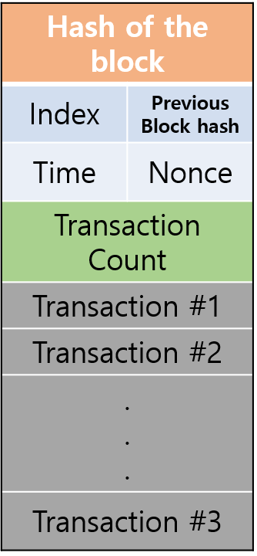
2
Product Details
3
Block chain Structure
System Connection Request
Node 1
Node 2
New Node
Hash of the block
Index | Previous Block hash
Time | Nonce
Transaction Count
Transaction #1
Transaction #2
. . .
Transaction #3
Hash of the block
Index | Previous Block hash
Time | Nonce
Transaction Count
Transaction #1
Transaction #2
. . .
Transaction #3
Hash of the block
Index | Previous Block hash
Time | Nonce
Transaction Count
Transaction #1
Transaction #2
. . .
Transaction #3
Hash of the block
Index | Previous Block hash
Time | Nonce
Transaction Count
Transaction #1
Transaction #2
. . .
Transaction #3
Hash of the block
Index | Previous Block hash
Time | Nonce
Transaction Count
Transaction #1
Transaction #2
. . .
Transaction #3
Hash of the block
Index | Previous Block hash
Time | Nonce
Transaction Count
Transaction #1
Transaction #2
. . .
Transaction #3
Connect
AND
Sharing Data
Node 3
Node 4
Hash of the block
Index | Previous Block hash
Time | Nonce
Transaction Count
Transaction #1
Transaction #2
. . .
Transaction #3
Hash of the block
Index | Previous Block hash
Time | Nonce
Transaction Count
Transaction #1
Transaction #2
. . .
Transaction #3
Hash of the block
Index | Previous Block hash
Time | Nonce
Transaction Count
Transaction #1
Transaction #2
. . .
Transaction #3
Hash of the block
Index | Previous Block hash
Time | Nonce
Transaction Count
Transaction #1
Transaction #2
. . .
Transaction #3
Hash of the block
Index | Previous Block hash
Time | Nonce
Transaction Count
Transaction #1
Transaction #2
. . .
Transaction #3
Hash of the block
Index | Previous Block hash
Time | Nonce
Transaction Count
Transaction #1
Transaction #2
. . .
Transaction #3

Slide 16
2
Product Details
3
Block chain Structure
Node 1
Node 2
Node 1
Node 2
Hash of the block
Index | Previous Block hash
Time | Nonce
Transaction Count
Transaction #1
Transaction #2
. . .
Transaction #3
Hash of the block
Index | Previous Block hash
Time | Nonce
Transaction Count
Transaction #1
Transaction #2
. . .
Transaction #3
Hash of the block
Index | Previous Block hash
Time | Nonce
Transaction Count
Transaction #1
Transaction #2
. . .
Transaction #3
Hash of the block
Index | Previous Block hash
Time | Nonce
Transaction Count
Transaction #1
Transaction #2
. . .
Transaction #3
Hash of the block
Index | Previous Block hash
Time | Nonce
Transaction Count
Transaction #1
Transaction #2
. . .
Transaction #3
Hash of the block
Index | Previous Block hash
Time | Nonce
Transaction Count
Transaction #1
Transaction #2
. . .
Transaction #3
Hash of the block
Index | Previous Block hash
Time | Nonce
Transaction Count
Transaction #1
Transaction #2
. . .
Transaction #3
Hash of the block
Index | Previous Block hash
Time | Nonce
Transaction Count
Transaction #1
Transaction #2
. . .
Transaction #3
Hash of the block
Index | Previous Block hash
Time | Nonce
Transaction Count
Transaction #1
Transaction #2
. . .
Transaction #3
Hash of the block
Index | Previous Block hash
Time | Nonce
Transaction Count
Transaction #1
Transaction #2
. . .
Transaction #3
Hash of the block
Index | Previous Block hash
Time | Nonce
Transaction Count
Transaction #1
Transaction #2
. . .
Transaction #3
Hash of the block
Index | Previous Block hash
Time | Nonce
Transaction Count
Transaction #1
Transaction #2
. . .
Transaction #3
PoW
Node 3
Node 4
Node 3
Node 4
Hash of the block
Index | Previous Block hash
Time | Nonce
Transaction Count
Transaction #1
Transaction #2
. . .
Transaction #3
Hash of the block
Index | Previous Block hash
Time | Nonce
Transaction Count
Transaction #1
Transaction #2
. . .
Transaction #3
Hash of the block
Index | Previous Block hash
Time | Nonce
Transaction Count
Transaction #1
Transaction #2
. . .
Transaction #3
Hash of the block
Index | Previous Block hash
Time | Nonce
Transaction Count
Transaction #1
Transaction #2
. . .
Transaction #3
Hash of the block
Index | Previous Block hash
Time | Nonce
Transaction Count
Transaction #1
Transaction #2
. . .
Transaction #3
Hash of the block
Index | Previous Block hash
Time | Nonce
Transaction Count
Transaction #1
Transaction #2
. . .
Transaction #3
Hash of the block
Index | Previous Block hash
Time | Nonce
Transaction Count
Transaction #1
Transaction #2
. . .
Transaction #3
Hash of the block
Index | Previous Block hash
Time | Nonce
Transaction Count
Transaction #1
Transaction #2
. . .
Transaction #3
Hash of the block
Index | Previous Block hash
Time | Nonce
Transaction Count
Transaction #1
Transaction #2
. . .
Transaction #3
Hash of the block
Index | Previous Block hash
Time | Nonce
Transaction Count
Transaction #1
Transaction #2
. . .
Transaction #3
Hash of the block
Index | Previous Block hash
Time | Nonce
Transaction Count
Transaction #1
Transaction #2
. . .
Transaction #3
Hash of the block
Index | Previous Block hash
Time | Nonce
Transaction Count
Transaction #1
Transaction #2
. . .
Transaction #3
Abnormal
data change

Slide 17
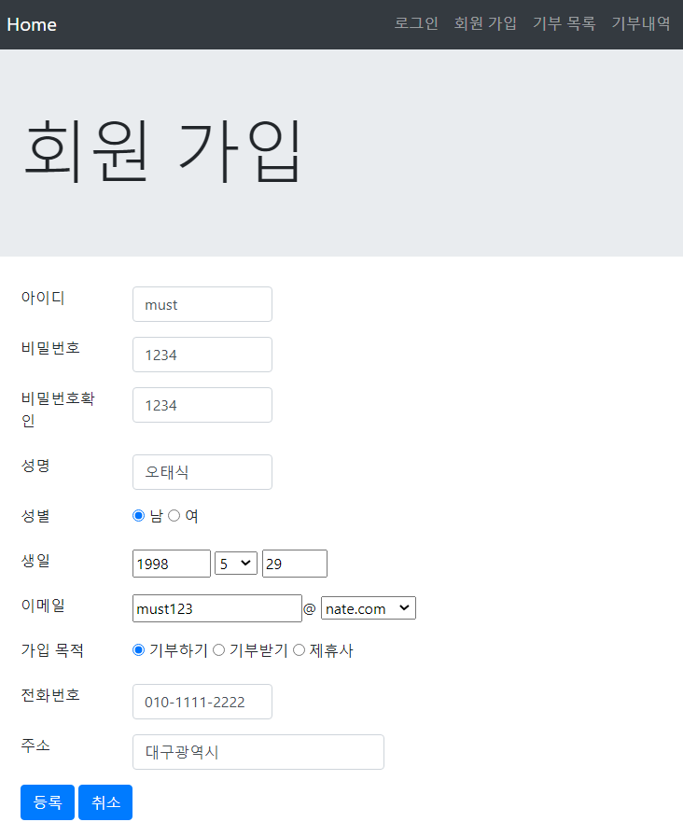
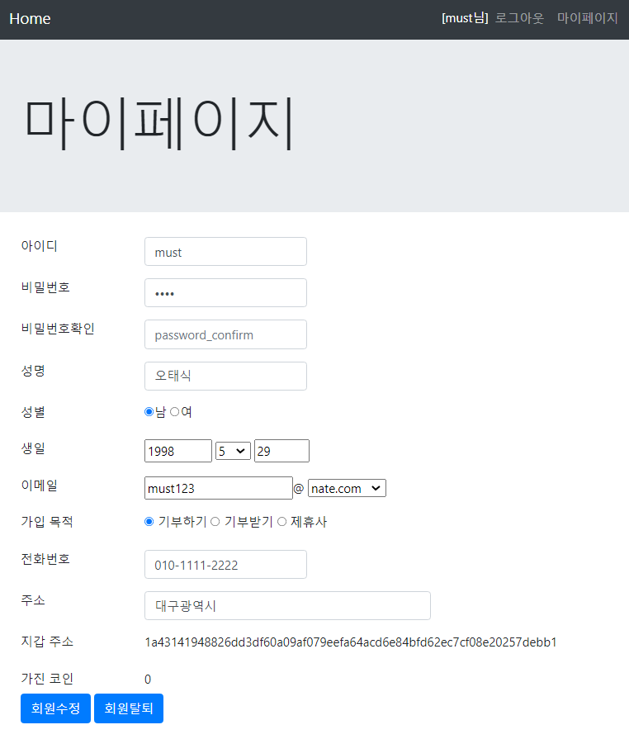
3
Product Details
Web Application Demo Video

Slide 18
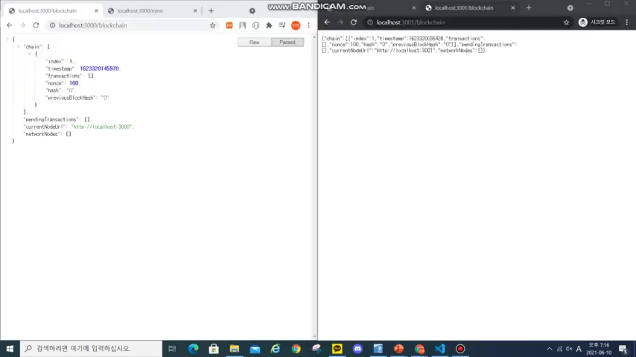
3
Product Details
Web Application Demo Video

Slide 19
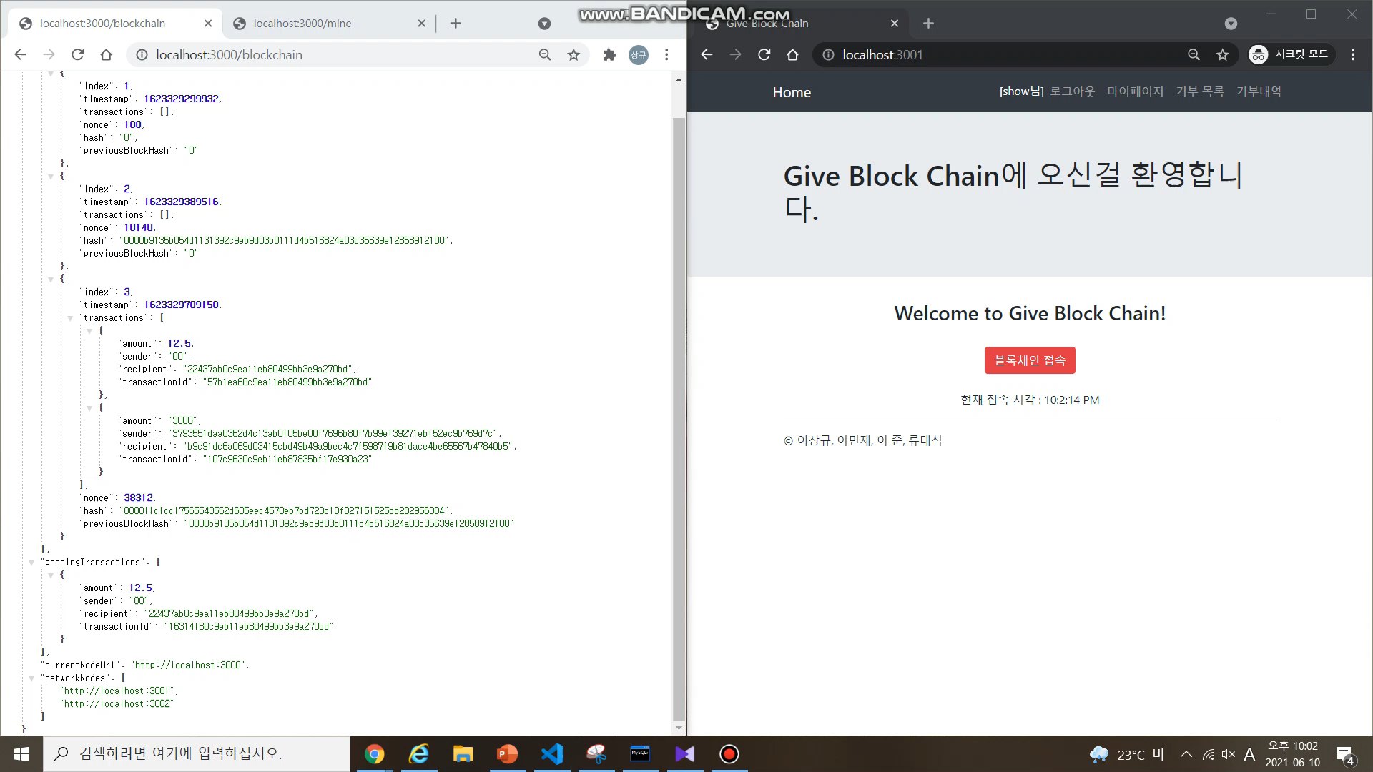
3
Product Details
Web Application Demo Video

Slide 20
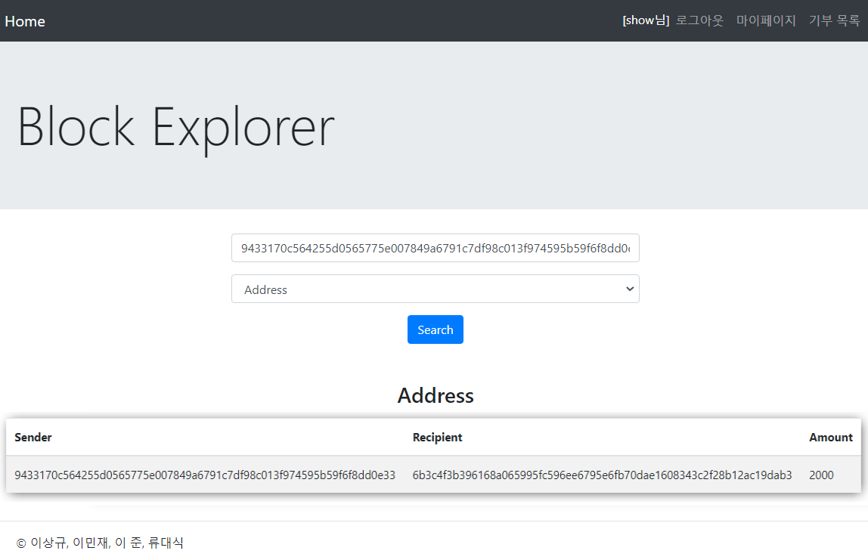
3
Product Details
Web Application Demo Video

Slide 21
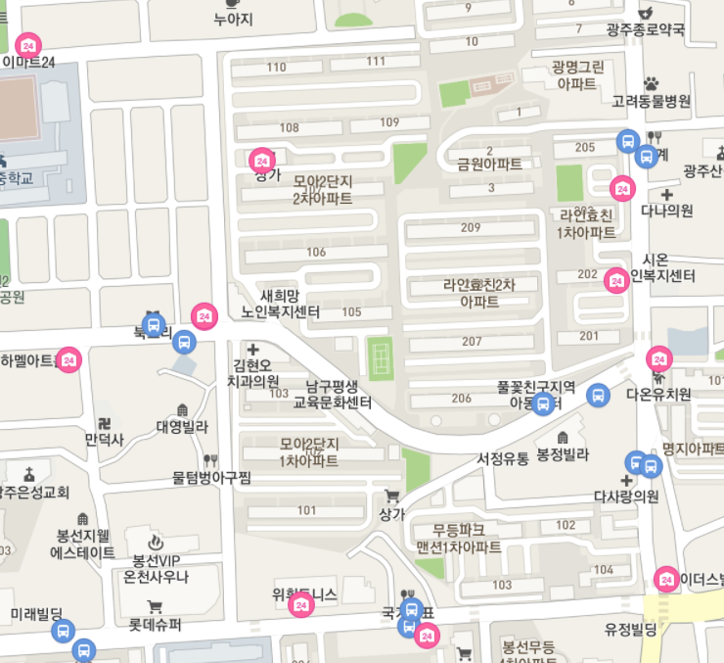
2
Product Details
3
Block chain Structure
Market_address
서비스나 재화를 제공하는 가게들과 제휴를 맺어
마켓 노드로 각각 가게들에게 지갑 주소를 부여
기부 받은 사람들이 마켓 지갑으로 코인을 송금한 후
직접 필요 물품을 제공 받아서 거래 내역이
블록체인 시스템에 기록되어 사용처를 확실하게 한다.

Slide 22
Expectation effectiveness
4

Slide 23

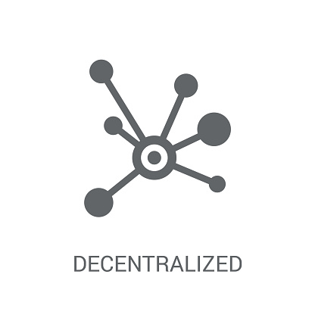

4
Expectation Effectiveness
Cost-cutting
Increase in donation participation rate
Revitalize the local economy
Notes:
기존의 중앙집중형의 시스템을 탈중앙화하면서 시스템을 운영하고 유지보수하는데에 필요한 비용을 절감할 수 있으므로 그만큼 기부자체에 더욱 집중할 수 있게됩니다.
신뢰성있고 투명한 기부시스템은 기부희망자들에게 확실히 기부에 동기부여를 해줄것이고, 이를 통해 기부금과 기부참여자의 비율을 증가시킬것입니다.
그리고 온, 오프라인 마켓의 이용을 통해 경제활동에 참여가 힘들었던 사람들이 기부금을 받아서 사용함으로써 지역 경제활성화에 도움을 줄 수 있을것입니다.

Slide 24
Thank You

